Slide 1

14 MAY 2018
E.A. TECHNIQUE (M) BERHAD
24th ANNUAL GENERAL MEETING
PERMATA BALLROOM,
THE PUTERI PACIFIC
JOHOR BAHRU

Slide 2
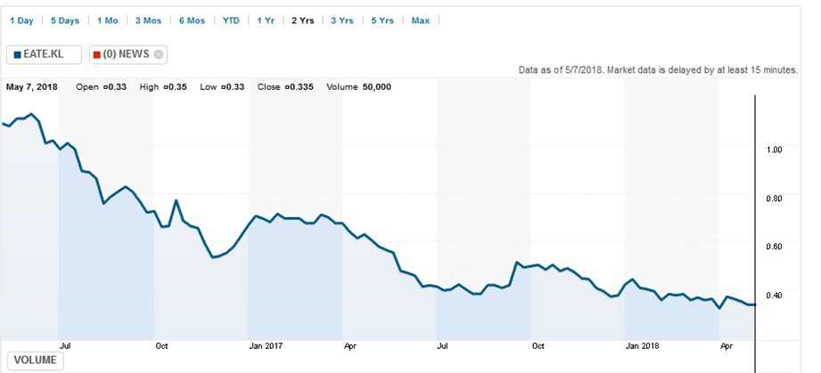
CORPORATE OVERVIEW
Incorporated on 18 January 1993 as a private limited company as E.A. Technique (M) Sdn Bhd.
Secured PETRONAS license in 1995.
Dato’ Hak appointed Managing Director in 2002
Kulim (M) Berhad holds a 50.6% equity and has been a shareholder since Dec 2006.
Listed on Bursa Malaysia Main Board on 11 December 2014

Slide 3
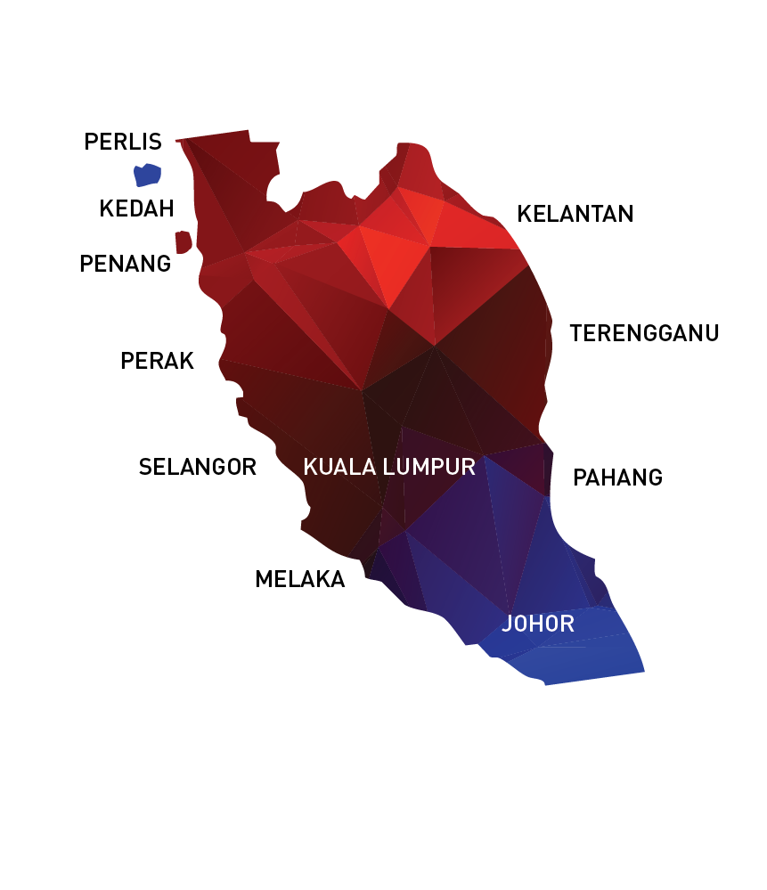
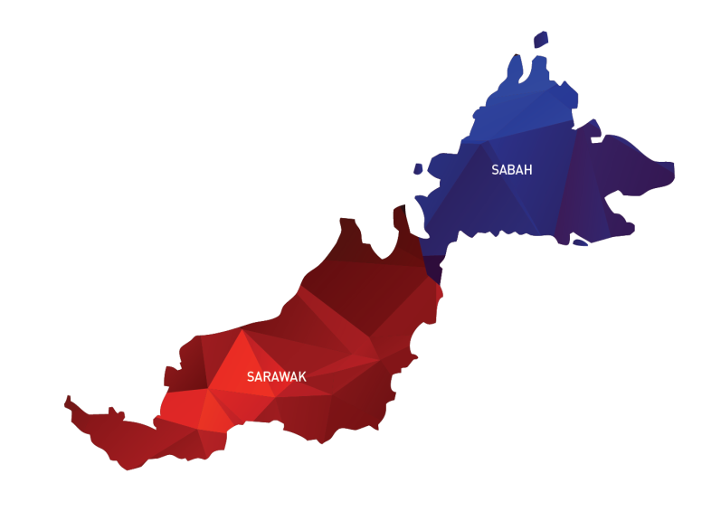
OUR OFFICES / OPERATION LOCATIONS
NO | OFFICE | LOCATION
1 | HEADQUARTERS | UNIT C-3A-3A, SETIAWANGSA BUSINESS SUITE, KUALA LUMPUR
2 | PROJECT OFFICE | UNIT B-1-1, SETIAWANGSA BUSINESS SUITE, KUALA LUMPUR
3 | BRANCH OFFICE | NORTHPORT, PELABUHAN KLANG
4 | BRANCH OFFICE | SG. UDANG PORT, MELAKA
5 | BRANCH OFFICE | KERTIH PORT, TERENGGANU
6 | BRANCH OFFICE | BINTULU PORT, SARAWAK
7 | SITE PROJECT OFFICE | PASIR GUDANG, JOHOR
8 | JOHOR SHIPYARD & ENGINEERING SDN. BHD. | HUTAN MELINTANG, PERAK

Slide 4
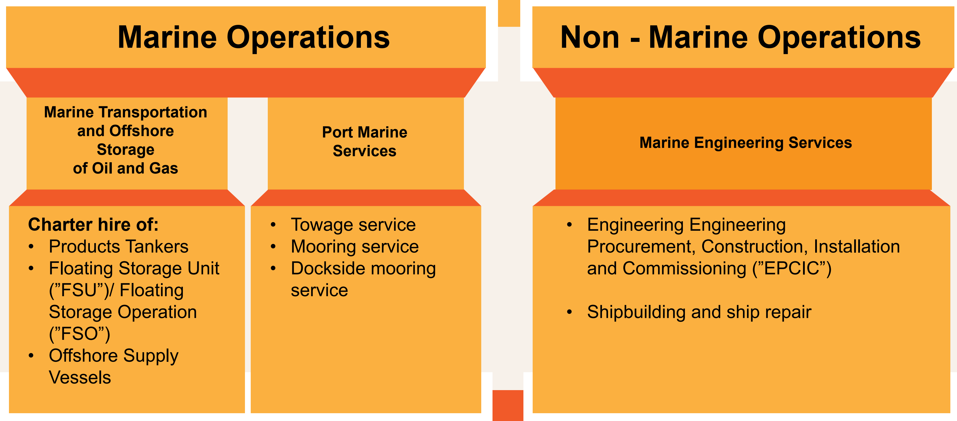
BUSINESS OVERVIEW

Slide 5

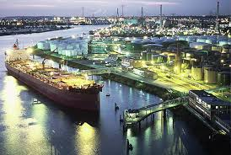

OIL & GAS VALUE CHAIN
Where is EA Technique?
Upstream
Field and production operations (OSV)
Offshore storage
Midstream
Transportation
Port operations
Downstream
Refining & petro chemical products
Port operations

Slide 6
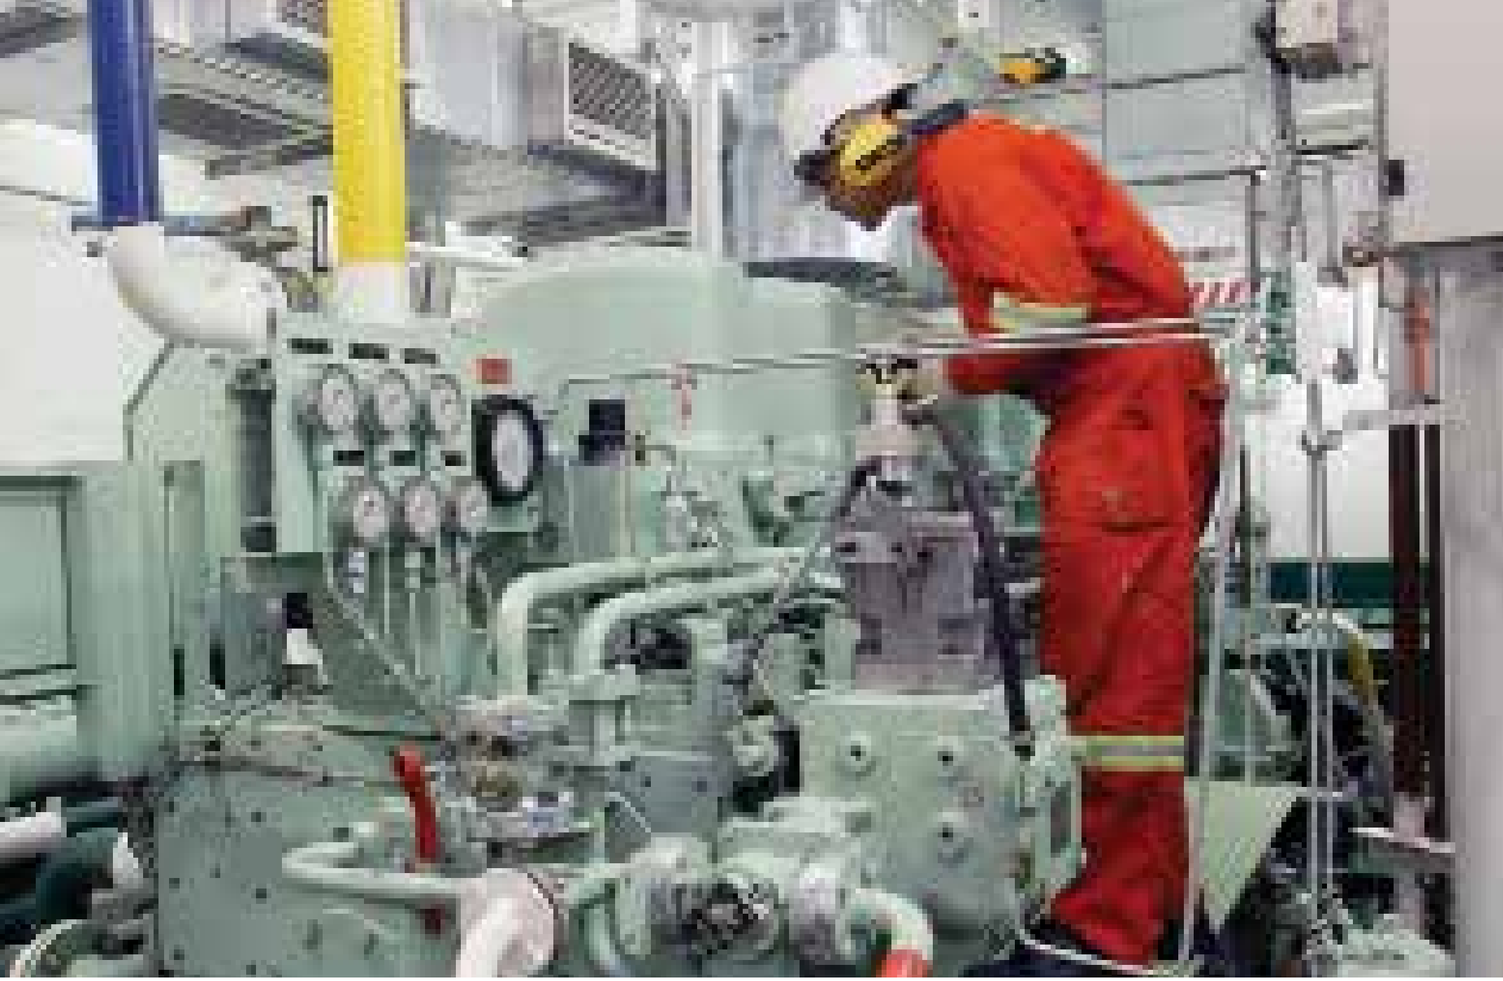
MARINE VESSEL FLEET
E.A. Technique operates a total fleet of 40 marine vessels, and 3 charter in vessels
OIL TANKERS
MT PRINCESS SOFEA
MT NAUTICA JOHOR BAHRU
MT NAUTICA MAHARANI
MT NAUTICA BATU PAHAT
MT NAUTICA KOTA TINGGI
MT NAUTICA RENGGAM
MT NAUTICA PAGOH
FLOATING STORAGE OFFLOADING
FSU NAUTICA MUAR
MT FOIS NAUTICA TEMBIKAI
PORT SERVICES
MV NAUTICA TG PUTERI I | MV NAUTICA TG PUTERI XXI
MV NAUTICA TG PUTERI II | MV NAUTICA TG PUTERI XXII
MV NAUTICA TG PUTERI VII | MV NAUTICA TG PUTERI XXIII
MV NAUTICA TG PUTERI VIII | MV NAUTICA TG PUTERI XXIV
MV NAUTICA TG PUTERI IX | MV NAUTICA TG PUTERI XXV
MV NAUTICA TG PUTERI X | MV NAUTICA TG PUTERI XXVI
MV NAUTICA TG PUTERI XI | MV NAUTICA TG PUTERI XXVII
MV NAUTICA TG PUTERI XII | MV NAUTICA TG PUTERI XXVIII
MV NAUTICA TG PUTERI XV | MV NAUTICA TG PUTERI XXIX
MV NAUTICA TG PUTERI XVI | MV NAUTICA TG PUTERI XXXIII
MV NAUTICA TG PUTERI XVII | MV NAUTICA TG PUTERI XXXIV
MV NAUTICA TG PUTERI XVIII | MV NAUTICA TG PUTERI XXXV
MV NAUTICA TG PUTERI XIX | MV NAUTICA TG PUTERI XXXVI
MV NAUTICA TG PUTERI XX | AMAL II
THIRD PARTY VESSEL
KEJORA 59
KEJORA 57
MT SUMMER CORAL
OFFSHORE SUPPORT (OSV)
MV NAUTICA TG PUTERI IV
MV NAUTICA TG PUTERI XXX
MV NAUTICA AIR HITAM

Slide 7
VESSEL UTILISATION
TYPE OF VESSEL | UTILISATION RATE JAN - DEC 2017 | UTILISATION RATE JAN - MAR 2018
Product Tankers | 72.58% | 76.83%
FSU | 37.99% | 100.00%
Fast Crew Boats | 58.92% | 52.50%
Harbour Tugboats | 95.75% | 98.12%
Utility Tugboats | 42.43% | 33.33%
Mooring Boats | 80.05% | 88.00%
Average Utilisation Rate | 80% | 88%

Slide 8

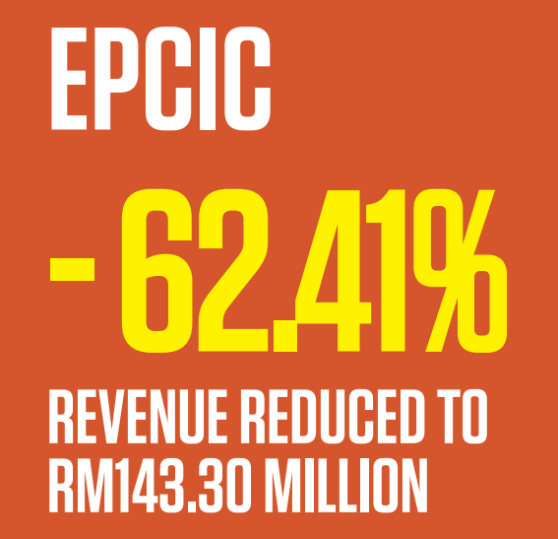
2017 OPERATIONAL PERFORMANCE

Slide 9
2017 OPERATIONAL HIGHLIGHTS
An unusual and challenging 2017 due to the EPCIC division underperformance due to losses as the results of higher costs incurred (compared to the contract sum).
Underlying core marine operations remains robust and underpinned by long term charters.
Three (3) new vessels contributed revenues for the first time in 2017 and will contribute for the full year in 2018 (FSU Fois Nautica Muar, M.T. Nautica Renggam and M.T. Nautica Pagoh)

Slide 10
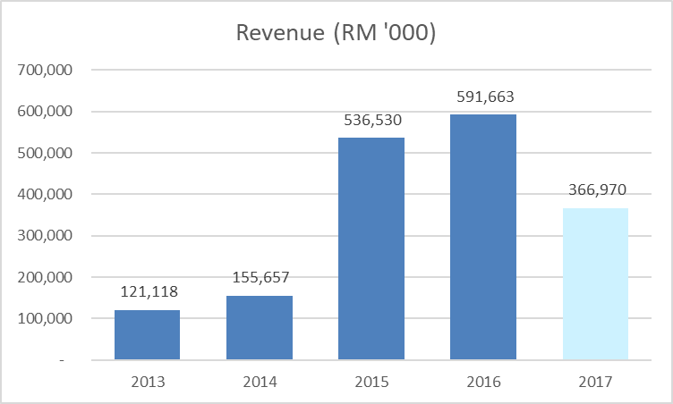
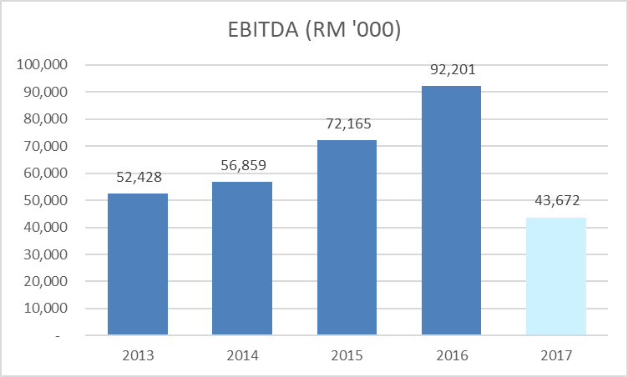
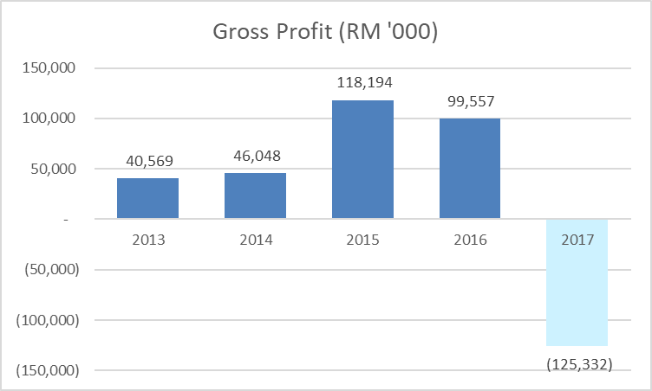
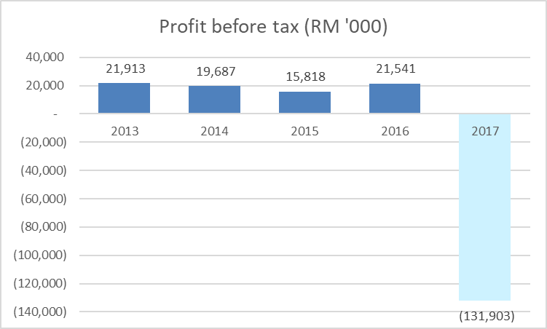
FINANCIAL HIGHLIGHTS – FY12 / 2017

Slide 11
GOING FORWARD
Focus on growing revenues and returning to profitability
Target to handover the EPCIC project in the first half of 2018 and thereafter to return to our core competencies of marine operations but focusing on securing more charters in both the Oil & Gas as well as port operation segments.
Focus on core competencies
The group will seek to improve operational efficiency through aggressive cost management and enhance efficiency in our existing marine operations. The group’s existing order book as at end 2017 stands at RM609 million with an extension period worth an additional RM329 million. At the current month, the group’s order book was approximately RM776.55 million with additional RM375.55 million for extension period.
Focus on fiscal discipline and financial resilience
The group remain committed to strengthening our balance sheet to further enhance the group’s financial health in order to steer the group back onto the growth path.

Slide 12
THANK YOU
DATO’ IR. ABDUL HAK BIN MD. AMIN
Address:
Setiawangsa Business Suites
Unit C-3A-3A, No.2 Jalan Setiawangsa 11,
Taman Setiawangsa, 54200 Kuala Lumpur,
Malaysia.
Contact:
Tel : 03 4252 5422
Fax : 03 4252 2163 / 03 4251 2985
Email : eat@Eatechnique.com.my
QUESTIONS?

